Slide 1
COMPUTER ORGANIZATION AND ARCHITECTURE
Dr. Rizwan Khan
Head – Department of Computer Science and Engineering
(An NBA Accredited Program)
ABES Institute of Technology, Ghaziabad

Slide 2
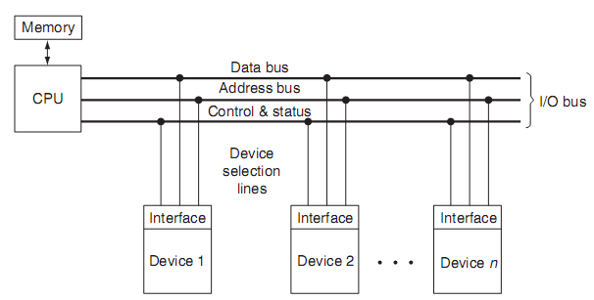
I/O BUS AND INTERFACE MODULES
Input/Output Interfaces
The I/O modules take care of moving data between main memory and a particular device interface. Interfaces are designed specifically to communicate with certain types of devices, such as keyboards, disks, or printers. Interfaces handle the details of making sure that devices are ready for the next batch of data, or that the host is ready to receive the next batch of data coming in from the peripheral device.

Slide 3
I/O MODULE
Interfaces
Internal Interface to the CPU and memory via the system Bus
External Interface to one or more I/O devices by tailored data links.
Requirements
Control & Timing
To coordinate the flow of traffic between internal resources and external devices
CPU Communication
Control signal to the I/O module over the control bus
Exchange of data between CPU and I/O module over data bus
Status signals like BUSY, READY needed as the data transfer rates of the CPU and the peripherals vary
Address of the various peripherals connected to CPU
Device Communication
Commands, status information and data
Data Buffering
Error Detection

Slide 4
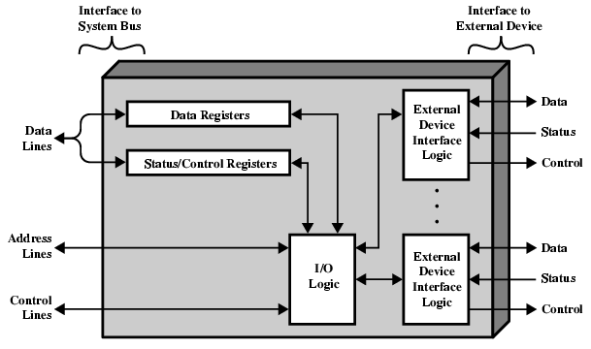

Slide 5
I/O BUS AND MEMORY BUS
Input/Output Interfaces
Functions of Buses
* MEMORY BUS is for information transfers between CPU and the MM
* I/O BUS is for information transfers between CPU
and I/O devices through their I/O interface
* Many computers use a common single bus system
for both memory and I/O interface units
- Use one common bus but separate control lines for each function
- Use one common bus with common control lines for both functions
* Some computer systems use two separate buses,
one to communicate with memory and the other with I/O interfaces
Physical Organizations

Slide 6


